Slide 1
Chapter Seven
Making the Most of Emotional Experiences:
Emotion-Focused Coping, Emotional Intelligence, Socioemotional Selectivity, and Emotional Storytelling
Positive Psychology: The Scientific and Practical Explorations of Human Strengths © 2019 SAGE

Slide 2
Introduction
Last chapter introduced you to positive and negative emotions
This chapter to focus on how we make the most of our emotional experiences; i.e., how we handle positive and negative emotions
Positive Psychology: The Scientific and Practical Explorations of Human Strengths © 2019 SAGE

Slide 3

Emotion-Focused Coping
Original view saw intense emotions as dysfunctional and irrational
Seen as “the beast within”
Annette Stanton, UCLA
  Emotions can be adaptive
  Discovered flaws in previous research
    “I get upset and let my emotions out” correlated with a negative view of self
  Studied emotion-focused coping
Positive Psychology: The Scientific and Practical Explorations of Human Strengths © 2019 SAGE

Slide 4
Approach Oriented Emotion-Focused Coping
Active movement toward, rather than away from, a stressful encounter
Emotional Approach-oriented (rather than avoidance)
Involves 2 related, yet distinct processes:
- Emotional processing
        Attempts to understand emotions
- Emotional expression
        Free and intentional displays of feeling
Positive Psychology: The Scientific and Practical Explorations of Human Strengths © 2019 SAGE

Slide 5
Emotion-Focused Coping
Involves 2 related, yet distinct processes:
  Emotional Processing
    Attempts to understand emotions
      I realize that my feelings are valid and important
      I take time to figure out what I am really feeling.
      I delve into my feelings to get a thorough understanding
      I acknowledge my emotions
  Emotional Expression
    Free and intentional displays of feeling
      I feel free to express my emotions
      I take time to express my emotions
      I allow myself to express my emotions
      I let my feelings come out freely
Positive Psychology: The Scientific and Practical Explorations of Human Strengths © 2019 SAGE

Slide 6
Emotion-Focused Coping
Research on effectiveness of approach-oriented emotion-focused coping and:
- cancer
- parental illness
- chronic racism
- infertility
- chronic pain
Positive Psychology: The Scientific and Practical Explorations of Human Strengths © 2019 SAGE

Slide 7

Emotion-Focused Coping: Cancer
Research on effectiveness of approach-oriented emotion-focused coping and:
  Breast Cancer
    Higher scores in emotion-focused coping:
      Perceived their health status as better
      Had lower psychological distress
      Had fewer medical appointments for
      cancer-related pain and ailments
Positive Psychology: The Scientific and Practical Explorations of Human Strengths © 2019 SAGE

Slide 8
Emotion-Focused Coping:
Parental Illness
Research on effectiveness of approach-oriented emotion-focused coping and:
  Parental Illness
    Students coped better with stressors if they were assigned to sessions that matched their emotional approach tendencies
      Those with preference for expressing emotions did better when attending sessions that allowed them to vent emotions
      Others did better when placed in sessions that provided information and facts
Positive Psychology: The Scientific and Practical Explorations of Human Strengths © 2019 SAGE

Slide 9
Emotion-Focused Coping:
Racism
Research on effectiveness of approach-oriented emotion-focused coping and:
  Chronic Racism
    Positive appraisal of emotion-focused coping options may intervene in the relationship between self-esteem, life satisfaction, and racial identity development
      Those who feel they have ways of coping emotionally with experiences of discrimination (i.e., strong identification with racial group) tend to have greater self-esteem and greater life satisfaction
Positive Psychology: The Scientific and Practical Explorations of Human Strengths © 2019 SAGE

Slide 10
Emotional Expression and Culture
Westerners seem to benefit from expressing emotions in a meaningful way.
Asian cultures encourage suppression of emotion, to preserve harmony
  With exception: it may be encouraged in close interpersonal relationships
Emotional suppression in Chinese not necessarily associated with negative core
Asians who are expected to emote expressively may feel stress.
Positive Psychology: The Scientific and Practical Explorations of Human Strengths © 2019 SAGE

Slide 11
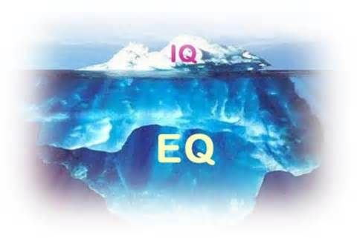
Emotional Intelligence
Early view of emotions as undermining intelligence
1960 – Mowrer: “emotion as a high order of intelligence”
Positive Psychology: The Scientific and Practical Explorations of Human Strengths © 2019 SAGE

Slide 12
Emotional Intelligence
Peter Salovey & John Mayer
  Define as the ability to:
    Recognize, understand and manage our own emotions
    Recognize, understand and influence the emotions of others
  View of emotional intelligence as adapting to life circumstances requires cognitive abilities and emotional skills
  Identified 3 core components of theory:
    Appraisal and expression
    Regulation
    Utilization
Positive Psychology: The Scientific and Practical Explorations of Human Strengths © 2019 SAGE

Slide 13
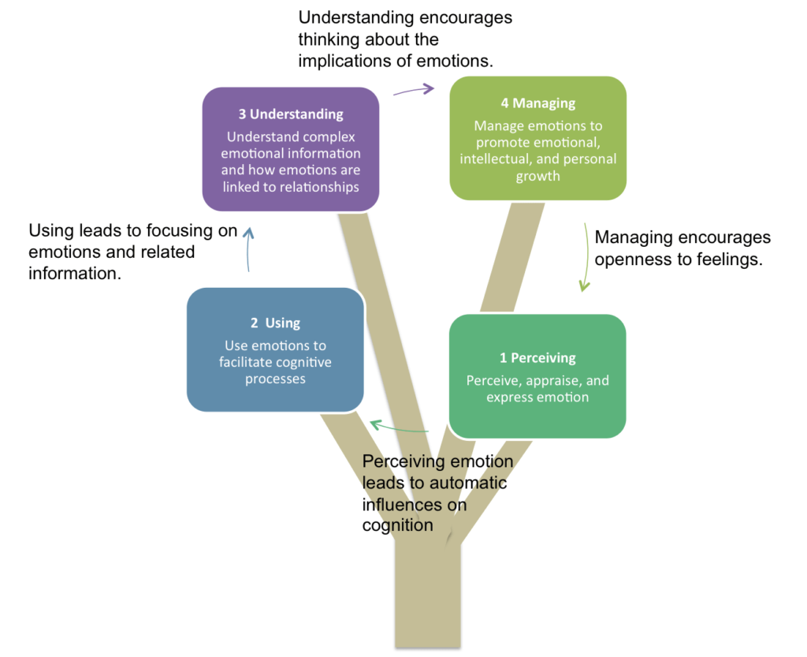
Positive Psychology: The Scientific and Practical Explorations of Human Strengths © 2019 SAGE

Slide 14
EI Four Branch Ability Model
Perceiving Emotions
  Ability to identify self and other’s emotions, express emotions accurately (e.g., nonverbal communication)
Using Emotions to Facilitate Thought
  Use emotions and emotional understanding to facilitate thinking
Understanding Emotions
  Skills needed to foster an understanding of complex emotions, relationships among emotions, and relationships between emotions and behavioral consequences
Managing Emotions
  Involves numerous mood regulation skills (too little…repressed; too much…overwhelmed)
Positive Psychology: The Scientific and Practical Explorations of Human Strengths © 2019 SAGE

Slide 15
EQ/EI Dimensions
Knowing one’s emotions
  Recognize what one is feeling and express it
Handle interpersonal relationships
  Socially competent
Motivate oneself
  Ability to control emotions to reach goals
Recognize emotions in others
Manage one’s emotions
  Regulate mood, handle stress, rebound after emotional setback
Positive Psychology: The Scientific and Practical Explorations of Human Strengths © 2019 SAGE

Slide 16
EQ/EI related to Well-Being?
People higher in EI had better relationships with friends and family and more satisfying romantic relationships (lower levels of conflict, more emotional support, more intimacy, more affection)
People high in EI reported higher life satisfaction and psychological well-being
Higher EI related to higher merit pay and higher rank within a company
Physicians had more satisfied patients and even better clinical outcomes
Positive Psychology: The Scientific and Practical Explorations of Human Strengths © 2019 SAGE

Slide 17
Emotional Intelligence
Can teach/learn the skills needed to:
- reason about emotions
- use emotional material to assist reasoning
Based upon the four-branch ability model
Positive Psychology: The Scientific and Practical Explorations of Human Strengths © 2019 SAGE

Slide 18
EQ and Mindfulness
Mindfulness
  John Kabat-Zinn “Mindfulness means paying attention in a particular way, on purpose, in the present moment nonjudgmentally”
3 Elements of Emotional Intelligence
  Emotional intelligence is the ability to identify and manage our emotions and those of other people.
    Emotional awareness
    Emotional application
    Emotional management
        (Emotional Intelligence 2016)
https://positivepsychologyprogram.com/mindfulness-emotional-intelligence/

Slide 19
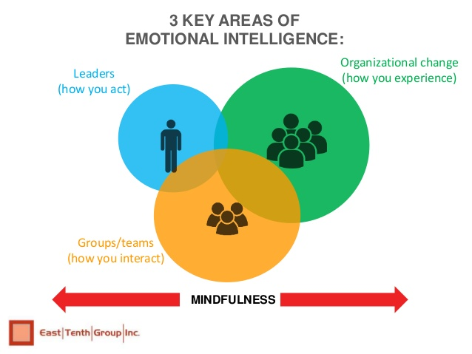
EQ, Mindfulness, Leadership
https://www.slideshare.net/mctenzyk/emotional-intelligence-mindfulness-how-much-do-they-matter-to-leadership

Slide 20
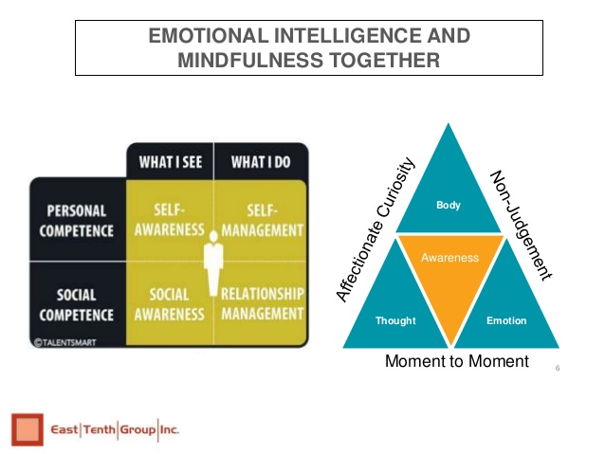
EQ, Mindfulness, Leadership
https://www.slideshare.net/mctenzyk/emotional-intelligence-mindfulness-how-much-do-they-matter-to-leadership

Slide 21
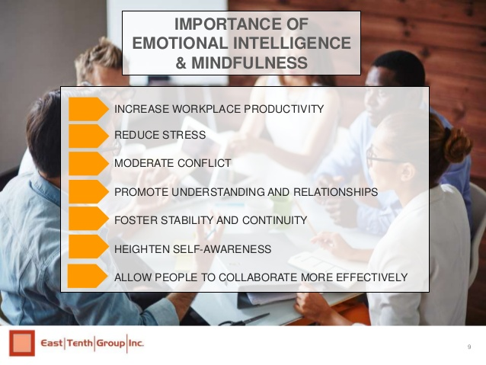
EQ, Mindfulness, Leadership
https://www.slideshare.net/mctenzyk/emotional-intelligence-mindfulness-how-much-do-they-matter-to-leadership

Slide 22
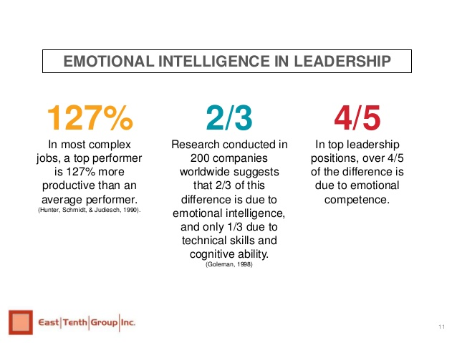
EQ, Mindfulness, Leadership
https://www.slideshare.net/mctenzyk/emotional-intelligence-mindfulness-how-much-do-they-matter-to-leadership

Slide 23
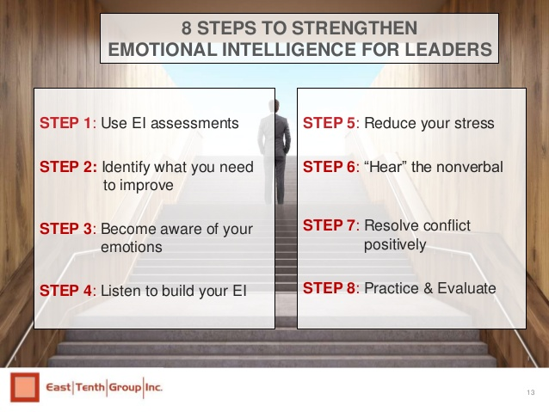
EQ, Mindfulness, Leadership
https://www.slideshare.net/mctenzyk/emotional-intelligence-mindfulness-how-much-do-they-matter-to-leadership

Slide 24
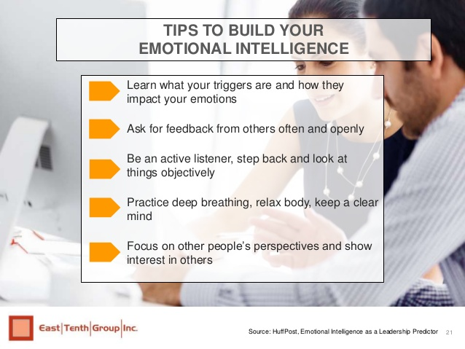
EQ, Mindfulness, Leadership
https://www.slideshare.net/mctenzyk/emotional-intelligence-mindfulness-how-much-do-they-matter-to-leadership

Slide 25
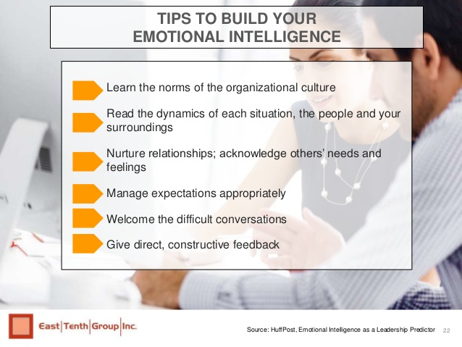
EQ, Mindfulness, Leadership
https://www.slideshare.net/mctenzyk/emotional-intelligence-mindfulness-how-much-do-they-matter-to-leadership

Slide 26
Emotional Intelligence
Mayer-Salovey-Caruso Emotional Intelligence Test (MSCEIT)
- 2 sets of tasks designed to assess each of the 4 branches of the ability model
Positive Psychology: The Scientific and Practical Explorations of Human Strengths © 2019 SAGE

Slide 27
Emotional Intelligence
Anecdotal evidence = children, youth, and adults can be taught to use emotional experiences adaptively
More empirical data needed to determine if E.I. can be enhanced via skill development programs
Positive Psychology: The Scientific and Practical Explorations of Human Strengths © 2019 SAGE

Slide 28
Description of the High EI Individual
Greater social effectiveness
Better at perceiving emotions
Better at using emotions and thought
Better at managing emotions
Less effort required to solve emotional problems
Drawn to occupations involving social interactions
Less apt to engage in problem behaviors
Positive Psychology: The Scientific and Practical Explorations of Human Strengths © 2019 SAGE

Slide 29
EI is Important
Discerning and understanding emotional information
Communicating basic feeling states between people
Some people are more skilled at EI
Associated with establishing positive social relationships
May provide coaching advice to others
Knowing one’s level is more important than scoring high on EI test
Positive Psychology: The Scientific and Practical Explorations of Human Strengths © 2019 SAGE

Slide 30
The Case of Maria, teacher
Success in the classroom was due to her ability to:
Perceive the emotions of her students
Use emotions to spark creativity
Understand the emotions of her students
Manage her own emotions as a role model
Positive Psychology: The Scientific and Practical Explorations of Human Strengths © 2019 SAGE

Slide 31
Socioemotional Selectivity
Laura Carstensen, Stanford
Theory: how people actively regulate aspects of their emotional lives throughout the lifespan
  Posits that psychological goals remain throughout the lifespan, but their salience changes depending on one’s place in the life cycle
    Example: drives to seek out info and to develop a positive self-concept are most important during adolescence and become less important with age
Positive Psychology: The Scientific and Practical Explorations of Human Strengths © 2019 SAGE

Slide 32
Carstensen
Posits people’s perception of how much time they have left in life exerts a powerful influence
Aged tend to perceive time as limited, so effects goals people choose to pursue
  Goals determine behavior and activities
  As we get older and realize fewer years are left, shift energy and attention from future goals and activities, more to the present
  Represents a shift from knowledge-related social goals that prepare us for future, to emotion-related social goals that maintain and enhance one’s present life situation
Positive Psychology: The Scientific and Practical Explorations of Human Strengths © 2019 SAGE

Slide 33
Carstensen Research
Older vs. Middle-aged Couples compared
Older showed better regulation of emotions while dealing with conflicts involving such issues as finances, children and in-laws
  Discussions characterized by less severe conflict; lower levels of anger, belligerence, and complaining; and more expressions of affection than discussions by middle-aged couples
Positive Psychology: The Scientific and Practical Explorations of Human Strengths © 2019 SAGE

Slide 34
Socioemotional Selectivity
Posits later years are valuable because:
We focus less on negative emotions
Engage more deeply with emotional content of our days
Savoring more of “the good stuff”
  Make social choices on the basis of potential for emotional rewards
Appreciation later in life due to realization that time is limited
Positive Psychology: The Scientific and Practical Explorations of Human Strengths © 2019 SAGE

Slide 35
Socioemotional Selectivity
Emotion-laden material handled differently by old vs. young:
  With novel stimuli, younger attended to negative images more quickly, older oriented faster to images with positive emotions
  Recall of emotional events: older recalled positive material more quickly than the negative material, “the positivity effect”
    Some conflicting results of “positivity effect”
Positive Psychology: The Scientific and Practical Explorations of Human Strengths © 2019 SAGE

Slide 36

Socioemotional Selectivity
As we age, positive experiences and positive emotions may become our priority as we consider our own mortality
Positive Psychology: The Scientific and Practical Explorations of Human Strengths © 2019 SAGE

Slide 37
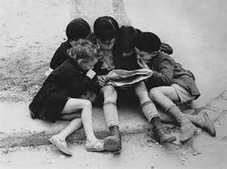
Emotional Storytelling
James Pennebaker, University of Texas
Studied emotional upheaval
Studied emotional storytelling of traumatic events via process of writing
Positive Psychology: The Scientific and Practical Explorations of Human Strengths © 2019 SAGE

Slide 38
Emotional Storytelling
Writing about emotional upheaval leads to health benefits
- especially when the writing contains:
more positive emotion words
more insight/causality
Very beneficial for those who prefer emotion-focused coping
Positive Psychology: The Scientific and Practical Explorations of Human Strengths © 2019 SAGE

Slide 39
Emotional Storytelling
95% probability that we will share emotional events with others.
Writing exercises associated with positive outcomes:
  Fewer physician visits
  Improvements in health
  Improvement in quality of life for breast cancer patients
  Benefits to gay and lesbian people dealing with discrimination.
Positive Psychology: The Scientific and Practical Explorations of Human Strengths © 2019 SAGE

Slide 40
Emotional Storytelling
Pennebaker Paradigm (systematic written disclosure across brief sessions) has been applied to:
- job loss
- diagnosis of illness
- relationship breakups
Positive Psychology: The Scientific and Practical Explorations of Human Strengths © 2019 SAGE

Slide 41
Emotional Storytelling
Works best (greater positive immune response) for those who are hostile (hostile have difficulty managing emotions)
Works well (health benefits) for those with alexithymia (difficulty identifying and making sense of emotions)
These findings suggest that people who typically do not have the tendency or skills to work with the emotionally laden content of life may benefit the most from emotional storytelling to process intense negative emotions
Positive Psychology: The Scientific and Practical Explorations of Human Strengths © 2019 SAGE

Slide 42
Emotions and Culture
Emotional experience is not universal:
Precursors differ based on context
  How we construe the current situation
Experience differs based on context
  E.g., expression (Western culture) vs. suppression (Eastern culture) of anger
Expressions differ based on context
  E.g., less intense emotional expression is more functional for Asian individuals
Positive Psychology: The Scientific and Practical Explorations of Human Strengths © 2019 SAGE

Slide 43
Life Enhancement Strategies
Love
Practice more “feeling words”
Set new goals for relationships
Work
Acknowledge emotional undercurrents of communication
Seek out EI at work seminars
Play
Become an emotional story teller
Learn and practice meditation skills
Positive Psychology: The Scientific and Practical Explorations of Human Strengths © 2019 SAGE

Slide 44
Mini-Experiments
Emotions Daily Journal
  Every 4 waking hrs for 2 days take 5min and note your feelings…reflect on experiences to determine if you approach or avoid provocative emotions
“Acting as If” You Were Emotional Intelligent for a Day
The Buoyant Grandparent Visit
Emotions in Cultural Context
Positive Psychology: The Scientific and Practical Explorations of Human Strengths © 2019 SAGE

Slide 45
The Happiness Advantage
Langer study: 75yo men lived for one week as 55 year old (1979…lived as if it were 1959). Hand strength, memory and eyesight improved. Others rated them as younger
“The mental construction of our daily activities, more than the activity itself, defines our reality.”
Positive Psychology: The Scientific and Practical Explorations of Human Strengths © 2019 SAGE

Slide 46
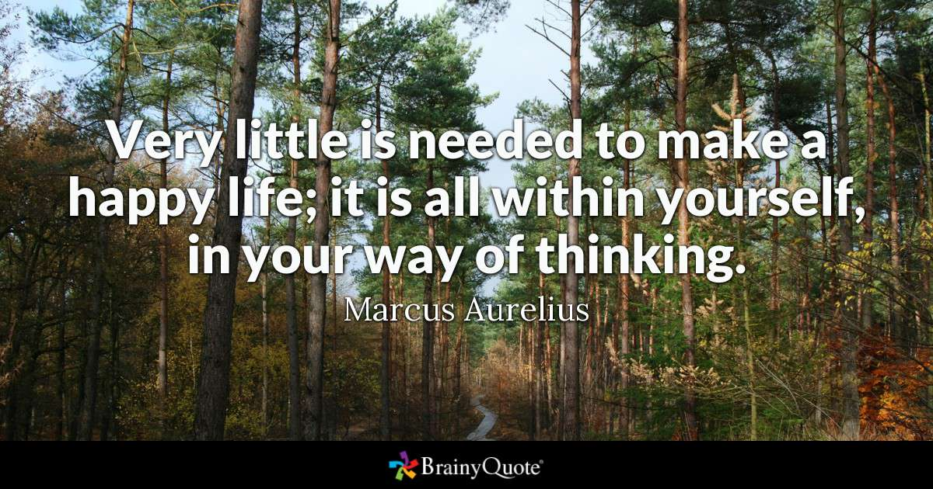
Positive Psychology: The Scientific and Practical Explorations of Human Strengths © 2019 SAGE

